Slide 1

Healthcare Data Analysis Platform Using AWS Services
By:
Akhil Gadige
Rutvik Sai Mittapalli

Slide 2
Overview
In the face of the COVID-19 pandemic, healthcare systems globally faced the urgent need for rapid and scalable data analysis solutions. This case study examines the deployment of Amazon Web Services (AWS) to create a comprehensive Healthcare Data Analysis Platform tailored for managing, analysing, and interpreting COVID-19-related data. The platform leveraged key AWS services to handle vast data volumes, maintain security and compliance, and deliver actionable insights to healthcare providers and policymakers, demonstrating the pivotal role of cloud technology in public health crises.

Slide 3
Introduction
The explosion of data volumes due to COVID-19 testing, patient records, and vaccinations has been a significant challenge and opportunity for healthcare systems worldwide.
The explosion of data volumes due to COVID-19 testing, patient records, and vaccinations.
The complexity of integrating diverse data types from multiple sources.
The critical need for real-time analytics to inform public health decisions.

Slide 4
Detailed Aws Workflow
AWS was selected for its robust cloud infrastructure, offering a suite of services that could be seamlessly integrated to construct a holistic data analysis platform. Key services included:
Amazon S3: Amazon Simple Storage Service (Amazon S3) is an object storage service offering industry-leading scalability, data availability, security, and performance. Organizations use S3 for a wide range of purposes:
AWS Glue: AWS Glue is a fully managed extract, transform, and load (ETL) service that makes it simple and cost-effective to categorize your data, clean it, enrich it, and move it reliably between various data stores.

Slide 5
Amazon Athena: Amazon Athena is an interactive query service that makes it easy to analyse data directly in Amazon S3 using standard SQL.
Amazon Redshift: Amazon Redshift is a fast, scalable data warehouse that makes it simple and cost-effective to analyse all your data across your data warehouse and data lake..
Amazon Vpc: A Service that allows users to provision a logically isolated section of the AWS Cloud where they can launch AWS resources in a virtual network, providing control over their virtual networking environment, including IP address ranges, subnets, and network gateways.
Amazon Quick Sight: Amazon Quick Sight is a cloud-based business intelligence (BI) service provided by Amazon Web Services (AWS).
These services provided the foundation for a scalable, secure, and agile platform capable of adapting to the evolving needs of the pandemic response.
Detailed Aws Workflow

Slide 6
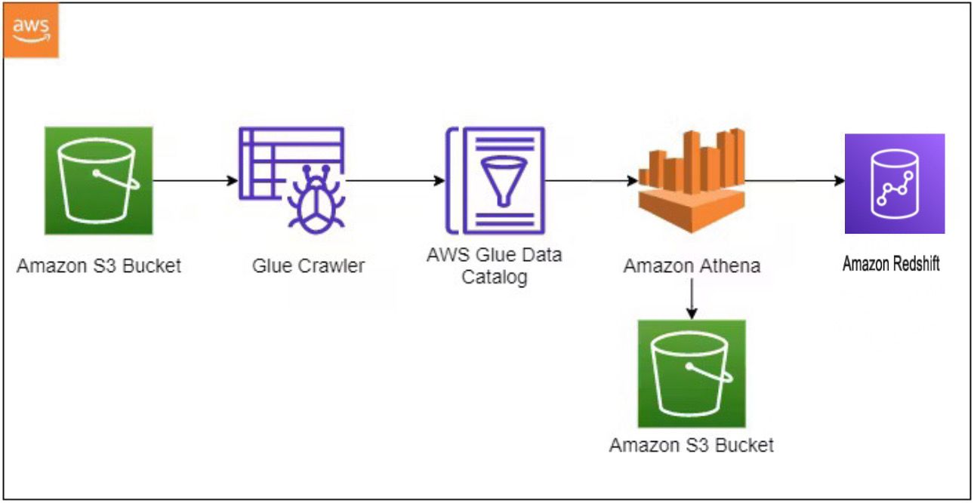

Slide 7
Detailed Workflow and Implementation
Data Collection and Storage: Data from a multitude of sources, such as electronic health records, diagnostic test results, and public health data, were consolidated on Amazon S3.
Data Cataloging and Management: AWS Glue Crawler automatically identified and cataloged the data stored in S3, simplifying data discovery and organization.
Data Processing and Analysis: AWS Glue Crawler automatically identified and cataloged the data stored in S3, simplifying data discovery and organization.

Slide 8

Security and Compliance

Slide 9
Security was paramount, and AWS services provided robust features to protect sensitive healthcare data. IAM was crucial in defining user permissions, ensuring that only authorized personnel could access the data. Compliance with healthcare regulations such as HIPAA was enforced through AWS's compliance programs, ensuring that the platform met all legal requirements for data protection.
Data Encryption
User Authentication
Compliance Badges

Slide 10
Benefits and Impact
The AWS-based platform had a tangible impact on public health responses. It facilitated the rapid identification of emerging COVID-19 hotspots and enabled the optimization of resource allocation to hospitals and clinics. The platform also supported vaccine rollout programs by providing logistics insights and tracking vaccination rates.

Slide 11
Conclusion
The deployment of the AWS Healthcare Data Analysis Platform during the COVID-19 pandemic highlighted the importance of cloud computing in addressing public health emergencies. The solution provided by AWS services showcased the benefits of a cloud approach in terms of scalability, security, and speed of deployment, setting a new standard for data-driven healthcare responses in times of crisis.

Slide 12
References
https://aws.amazon.com/health/
https://aws.amazon.com/health/case-studies/?case-studies-health-cards.sort-by=item.additionalFields.sortDate&case-studies-health-cards.sort-order=desc&awsf.case-studies-filter-area=*all
https://aws.amazon.com/blogs/industries/category/industries/healthcare/
https://aws.amazon.com/solutions/case-studies/change-healthcare/

Slide 13
Thank You

